Slide 1
Cryptography
Classical Ciphers

Slide 2
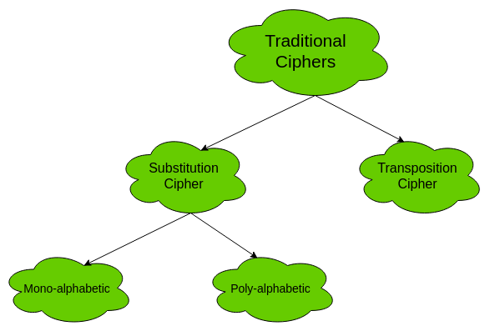
Traditional Symmetric Ciphers
The two types of traditional symmetric ciphers are Substitution Cipher and Transposition Cipher.
The following flowchart categories the traditional ciphers:

Slide 3
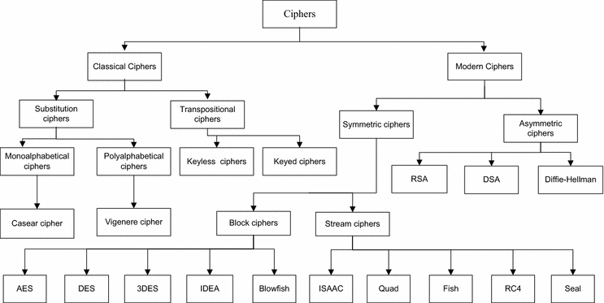


Slide 4
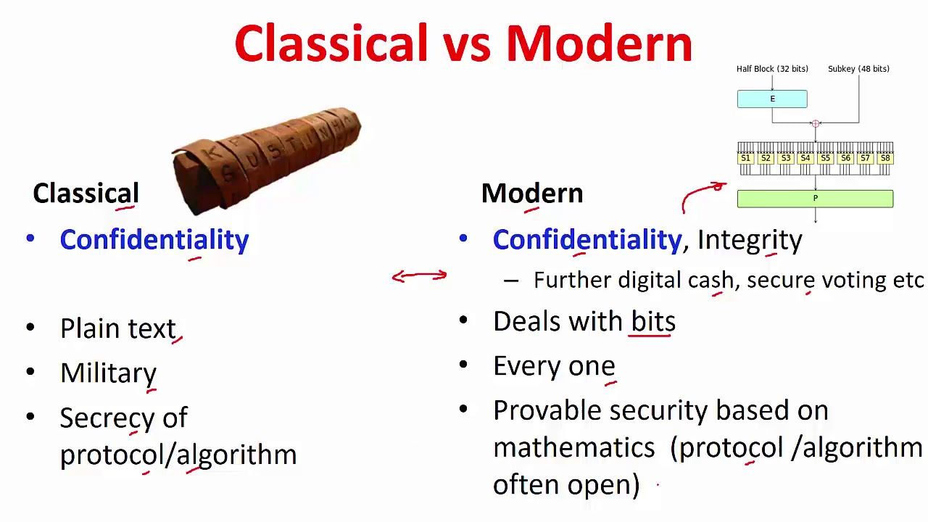

Slide 5
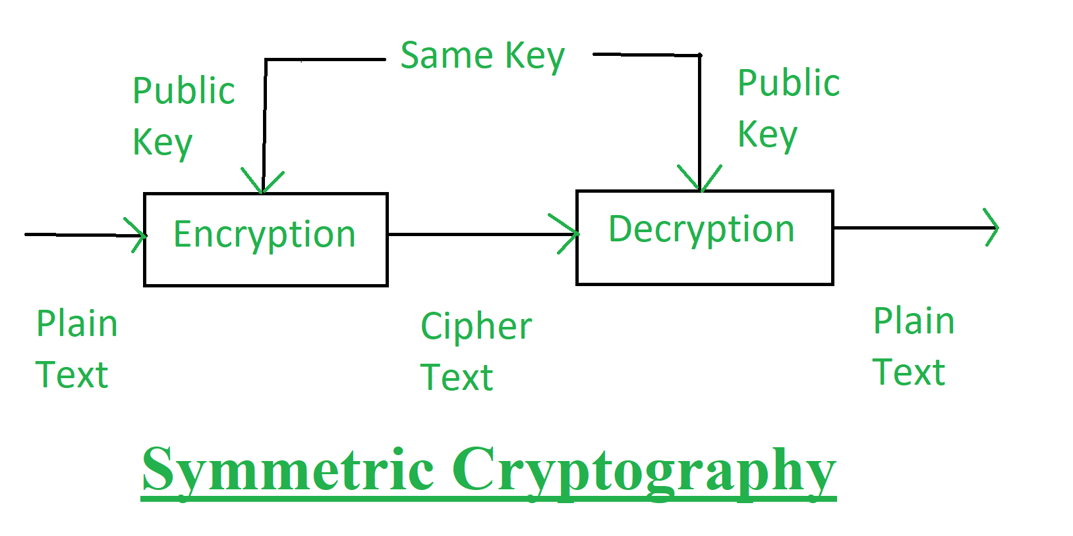
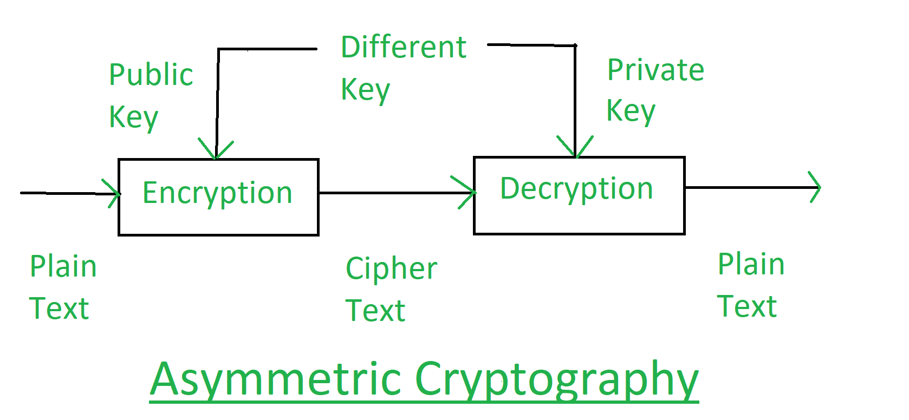
Role of Key In cryptography, a key is a piece of information (a parameter) that determines the functional output of a cryptographic algorithm.
For encryption algorithms, a key specifies the transformation of plaintext into ciphertext, and vice versa for decryption algorithms.

Slide 6
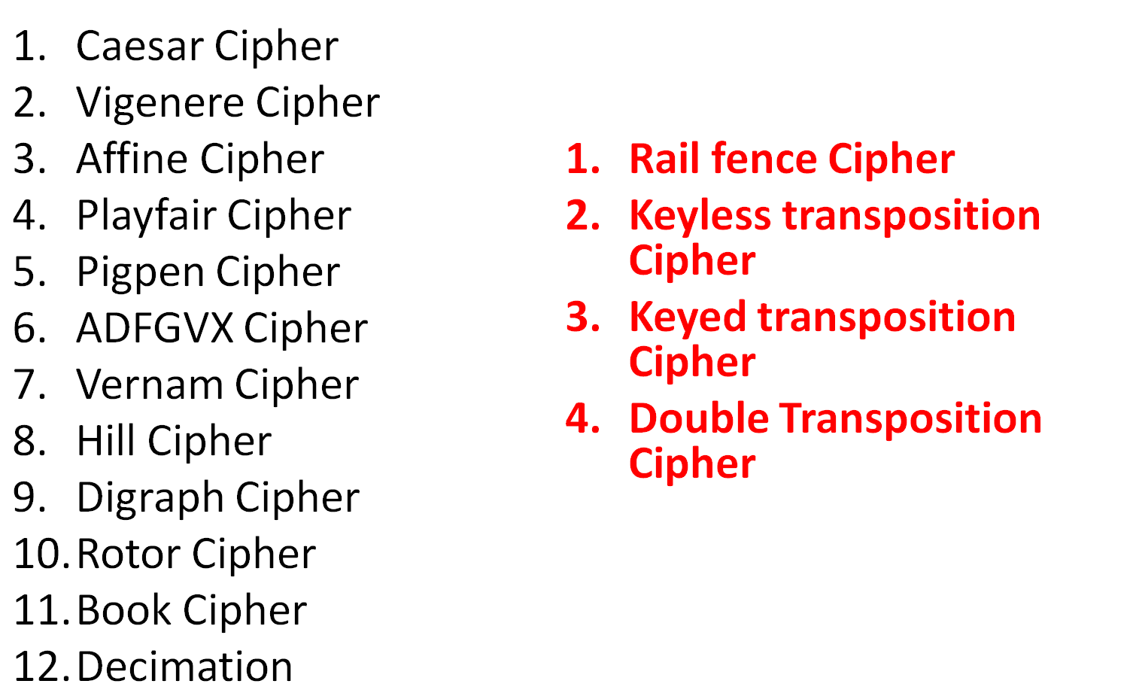
Various Ciphers

Slide 7
Digraph Cipher
Playfair Cipher
Hill cipher

Slide 8
Transposition Cipher
Keyless transposition Cipher
Keyed transposition Cipher
Double Transposition Cipher

Slide 9
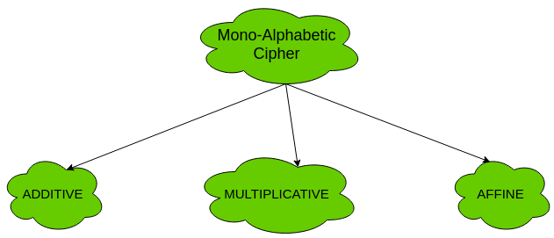
Types of mono-alphabetic ciphers are:

Slide 10
Caesar Cipher
earliest known substitution cipher
by Julius Caesar
first attested use in military affairs
replaces each letter by 3rd letter on
example:
  meet me after the toga party
  PHHW PH DIWHU WKH WRJD SDUWB

Slide 11
Caesar Cipher
can define transformation as:
  a b c d e f g h i j k l m n o p q r s t u v w x y z
  D E F G H I J K L M N O P Q R S T U V W X Y Z A B C
mathematically give each letter a number
  a b c d e f g h i j k l m n o p q r s t u v w x y z
  0 1 2 3 4 5 6 7 8 9 10 11 12 13 14 15 16 17 18 19 20 21 22 23 24 25
then have Caesar cipher as:
  c = E(p) = (p + k) mod (26)
  p = D(c) = (c – k) mod (26)

Slide 12
Cryptanalysis of Caesar Cipher
only have 26 possible ciphers
  A maps to A,B,..Z
could simply try each in turn
a brute force search
given ciphertext, just try all shifts of letters
do need to recognize when have plaintext

Slide 13
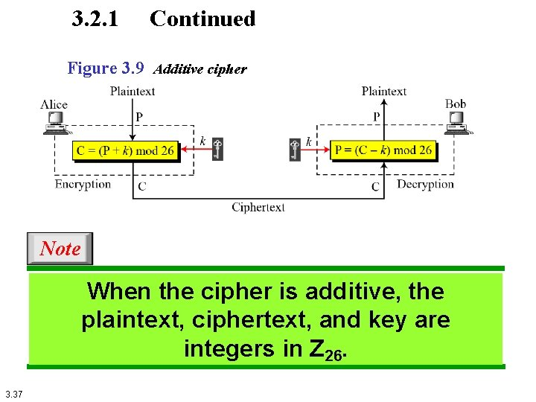
Additive Cipher

Slide 14
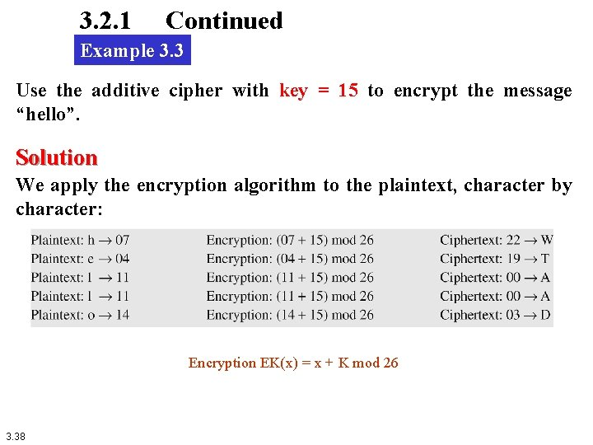

Slide 15
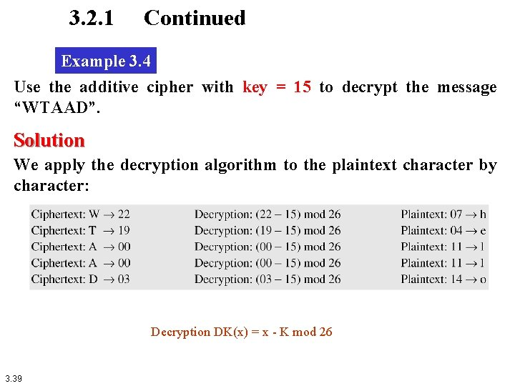

Slide 16
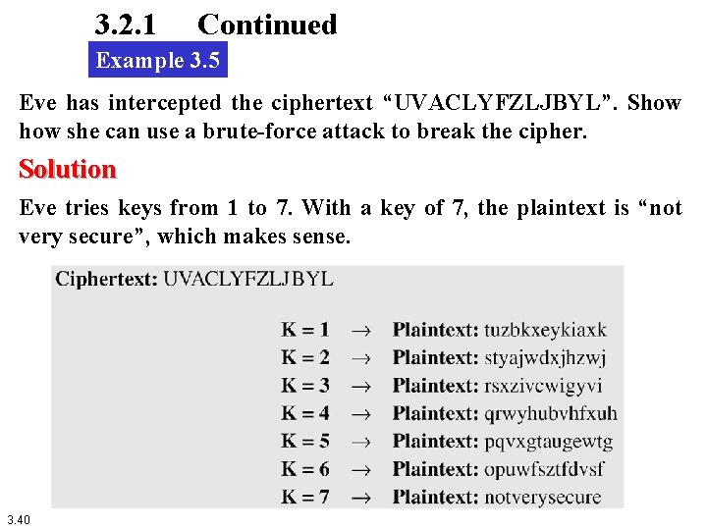

Slide 17
Multiplicative Cipher
The multiplicative cipher is similar to additive cipher except the fact that the key bit is multiplied to the plain-text symbol during encryption. Likewise, the cipher-text is multiplied by the multiplicative inverse of key for decryption to obtain back the plain-text.
C = (M * k) mod n
M = (C * k⁻¹) mod n
where,
k⁻¹ -> multiplicative inverse of k (key)
The key space of multiplicative cipher is 12. Thus, it is also not very secure.

Slide 18
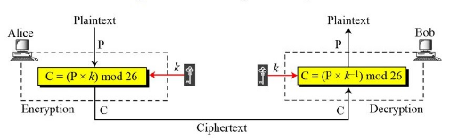
Multiplicative Cipher

Slide 19
Encryption
C = E(K,P)=(P*K) mod 26

Slide 20
Decryption
Decryption algorithm :
P=D(K,C)=(C*K⁻¹) mod 26

Slide 21
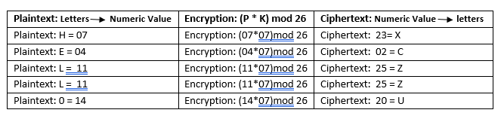
Example
encrypt the message "HELLO" using multiplicative cipher with key = 7

Slide 22
Table of Multiplicative Inverse
we must use a multiplier which is co-prime (the values do not share any factors when dividing in relation to the size of the alphabet (26), so you should use either 1, 3, 5, 7, 9, 11, 15, 17, 19, 21, 23 or 25.
key a | key a⁻¹
1 | 1
3 | 9
5 | 21
7 | 15
9 | 3
11 | 19
15 | 7
17 | 23
19 | 11
21 | 5
23 | 17
25 | 25

Slide 23
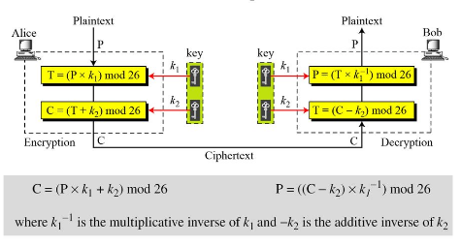
Affine Cipher

Slide 24
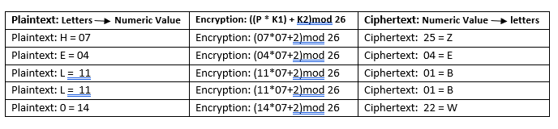
Example
Encrypt the message "HELLO" using Affine Cipher with key pair (7,2)
So, the ciphertext is " ZEBBW"

Slide 25
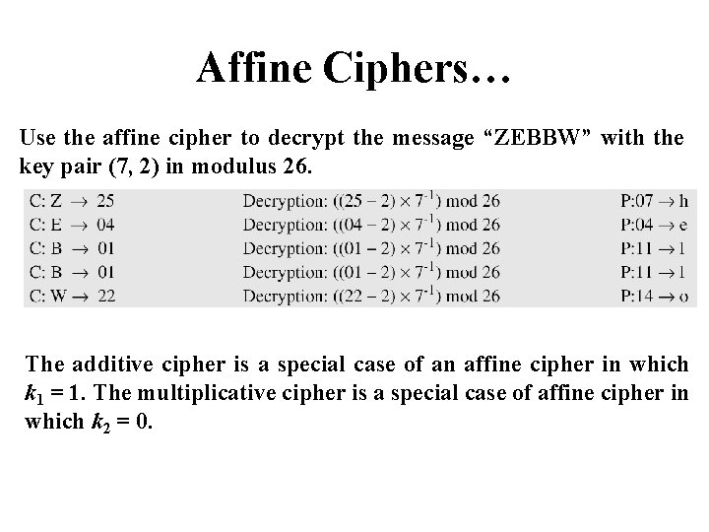

Slide 26
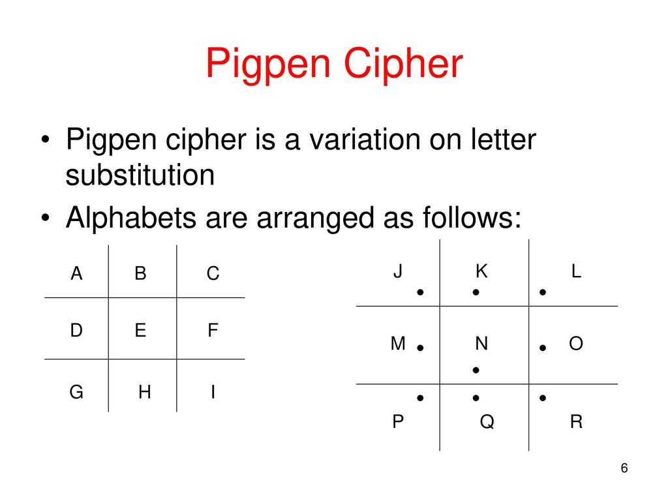

Slide 27
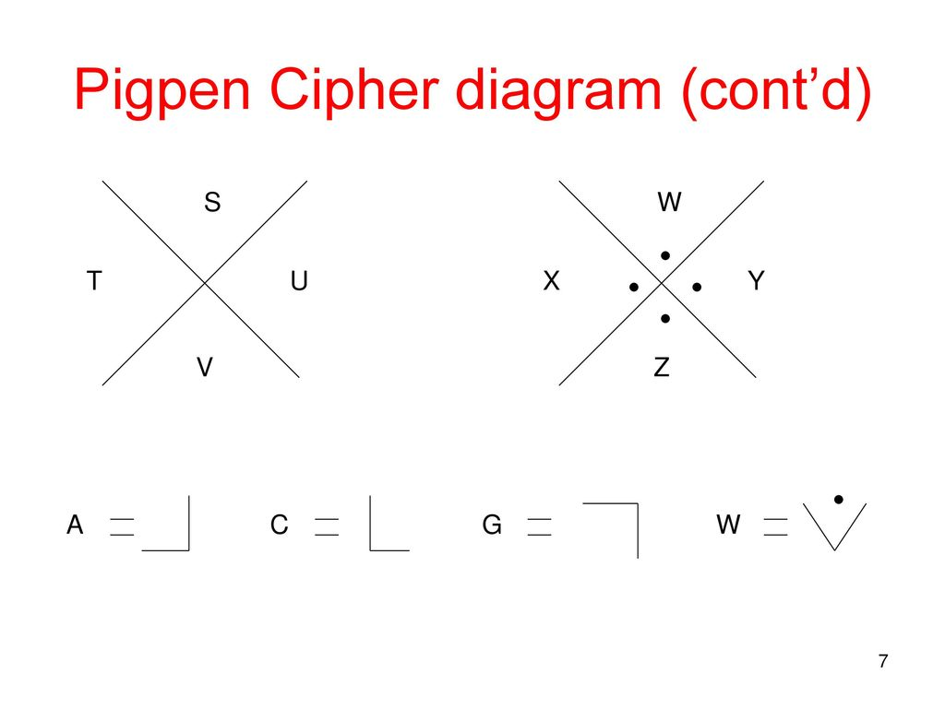

Slide 28
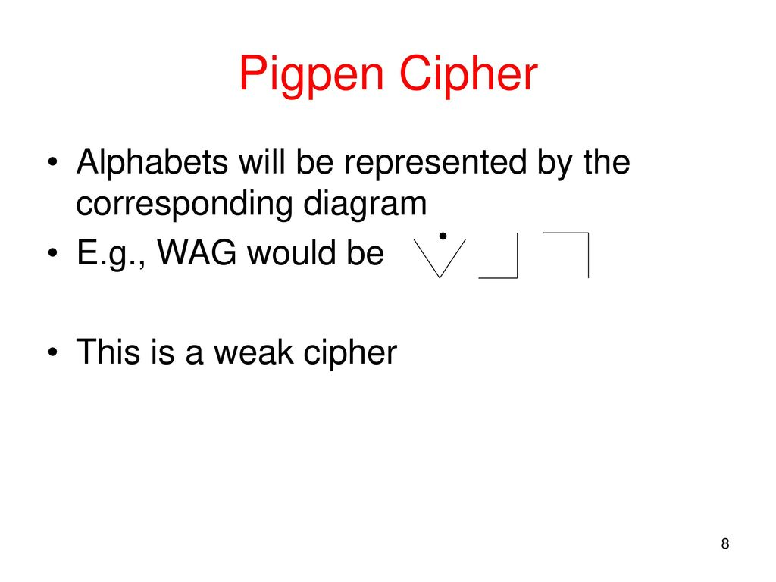

Slide 29
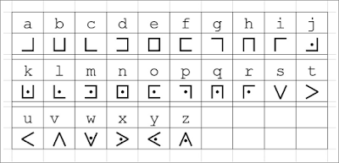

Slide 30

Decode the following pigpen ciphertext:
Encode the following message using the pigpen cipher:
the truth is out there

